Slide 1
DATA MINING
GROUP 04

Slide 2
members
TRAN HUY HIEP
NGUYEN THE HAO
PHAM CONG DINH
NGUYEN VIET ANH
NGUYEN DUC LOC

Slide 3
1.4: What Kinds of Patterns Can Be Mined?
1.4.1: Class/Concepts Description: Characterization and Discrimination.
Data characterization is a summarization of the general characteristics or features of a target class of data.
Example:
Summarize the characteristics of customers who spend more than $5000 a year at AllElectronics.
Result:
a general profile of these customers, such as that they are 40 to 50 years old, employed, and have excellent credit ratings

Slide 4
1.4.1: Class/Concepts Description: Characterization and Discrimination.
Data discrimination is a comparison of the general features of the target class data objects against the general features of objects from one or multiple contrasting classes.
Example:
compare two groups of customers—those who shop for computer products regularly (more than twice a month) and those who rarely shop for such products (less than three times a year).
Result:
provides a general comparative profile of these customers, such as that 80% of the customers who frequently purchase computer products are between 20 and 40 years old and have a university education, whereas 60% of the customers who infrequently buy such products are either seniors or youths, and have no university degree

Slide 5
1.4.2: Mining Frequent Patterns, Associations, and Correlations.
Frequent patterns, as the name suggests, are patterns that occur frequently in data.

Slide 6
1.4.3: Classification and Regression for Predictive Analysis
Classification is the process of finding a model (or function) that describes and distinguishes data classes or concepts. The derived model is based on the analysis of a set of training records, i.e., data objects whose class label is familiar.
Classification gives out discrete values.
The nature of the predicted data is unordered.

Slide 7
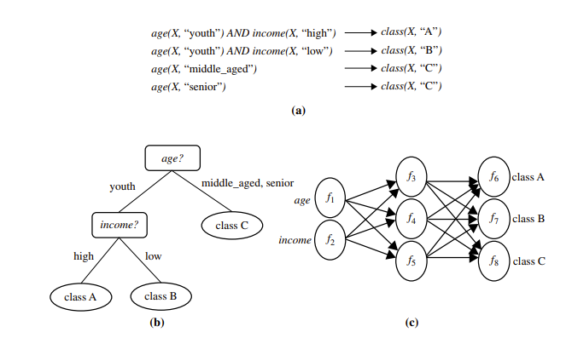
1.4.3: Classification and Regression for Predictive Analysis
The derived model may be represented in various forms:
Classification rules (i.e., IF-THEN rules)
Decision trees
Neural networks
Na¨ıve Bayesian classification
K-nearest-neighbor classification

Slide 8
1.4.3: Classification and Regression for Predictive Analysis
Example:
Spam detection
Image recognition
Sentiment analysis
Helps determine whether cell clusters are benign or malignant.

Slide 9
1.4.3: Classification and Regression for Predictive Analysis
While classification assigns data into discrete categories, Regression is a data mining technique used to predict a range of numeric values (also called continuous values), given a particular dataset.
Regression gives continuous values.
Output Variable Type is Continuous variable

Slide 10
1.4.3: Classification and Regression for Predictive Analysis
There are several types of regression models, including :
Linear regression
Logistic regression
Polynomial regression
Example:
Stock price prediction
House price prediction
Demand forecasting

Slide 11
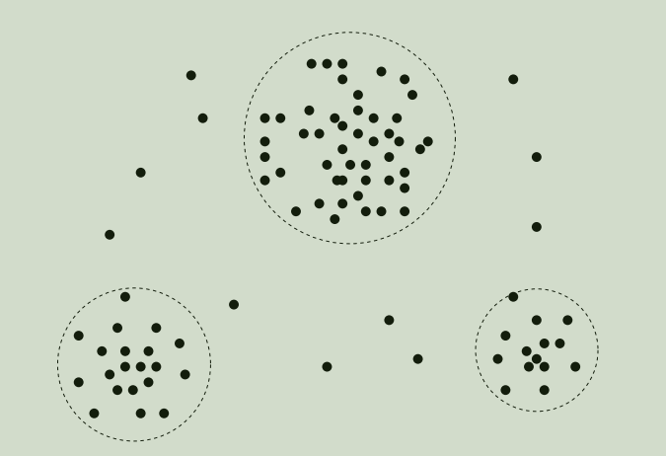
1.4.4: Cluster Analysis
analyze class-labeled (training) data sets, clustering analyzes data objects without consulting class labels
Example:
Cluster analysis identifies homogeneous customer groups. These clusters may represent individual target groups for marketing

Slide 12
1.4.4: Cluster Analysis
Capable of generating class labels for groups of data.
Objects are clustered based on the principle of enhancing intraclass similarity and minimizing similarity between different classes.
Each cluster represents a class of objects, from which rules can be generated

Slide 13
Aneural network, when used for classification, is typically a collection of neuron-like processing units with weighted connections between the
units.

Slide 14
1.4.5: Outlier Analysis
Outlier data is data set may contain objects that do not comply with the general behavior or model
of the data.
The analysis of outlier data is referred to as outlier analysis or anomaly mining.
Outliers may be detected :
Using statistical tests that assume a distribution.
Probability model for the data.
Using distance measures where objects that are remote from any other cluster are considered outliers
Rather than using statistical or distance measures, density-based methods may identify outliers in a local region, although they look normal from a global statistical distribution view.

Slide 15
1.4.6: Patterns Interesting
A pattern is interesting
+ Easily understood by humans
+ Valid on a new or test data with some degree of certainty
+ Potentially useful
+ Novel (new and original, not like anything seen before)
Objective interestingness measures: Accuracy and classification
That help identify interesting pattern. But they are often insufficient unless combined with subjective measure that reflect a particular user’s needs and interests.

